Slide 1
Fortinet High Performance Network Security
Data Connectors – Los Angeles
Edwin Mendoza – Manager Systems Engineering
1/23/2020

Slide 2
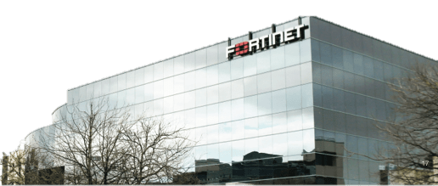
Company Introduction
A Leader in Network Security
Year Founded: Oct 2000
Fortinet IPO: Nov 2009 NASDAQ: FTNT
Headquarters: Sunnyvale, California
FY 2012 Revenue: $534M Q3 2013 Revenue: $155M+ $841M+ cash and no debt Profitable
First Product Release: May 2002
Units Shipped to Date: 1.3+ Million
Customers: 170,0000+
Patents: 143 patents issued 108 patents pending
One of the 3 Largest Network Security Vendors Worldwide
Leader in Unified Threat Management (UTM) MQ Since 2009

Slide 3
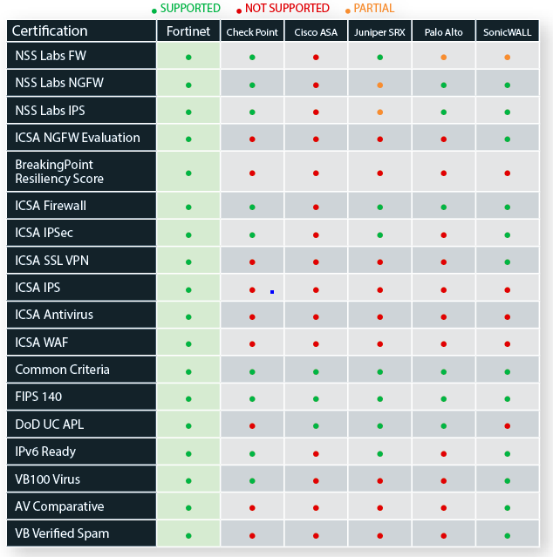
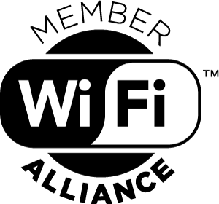
Feature & Certification Comparison No One Comes Close

Slide 4
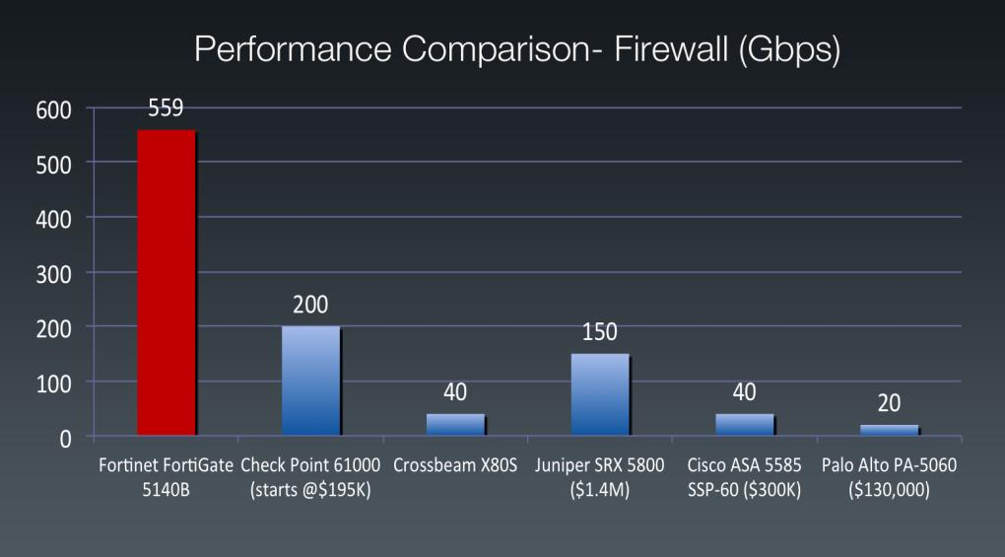
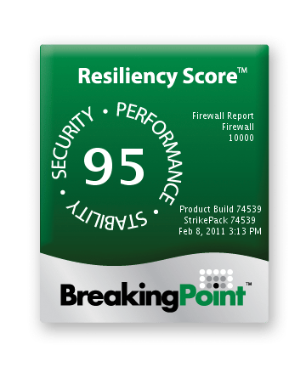
IXIA/BreakingPoint Testing World’s Fastest Firewall & Resiliency Score

Slide 5
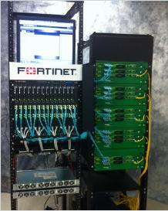
World’s Fastest IPv4 and IPv6 Firewall
Tests Using BreakingPoint™ FireStorm Prove FortiGate-5140B to be the World's Fastest Firewall
FortiGate-5001B
FortiGate-5101C
IPv4 | IPv6
559 Gbps of UDP traffic 526 Gbps of mix application traffic 2.6 Million new connections/sec | 536 Gbps of UDP traffic 514 Gbps of mix application traffic 1.4 Million new connections/sec
Real-World Testing

Slide 6
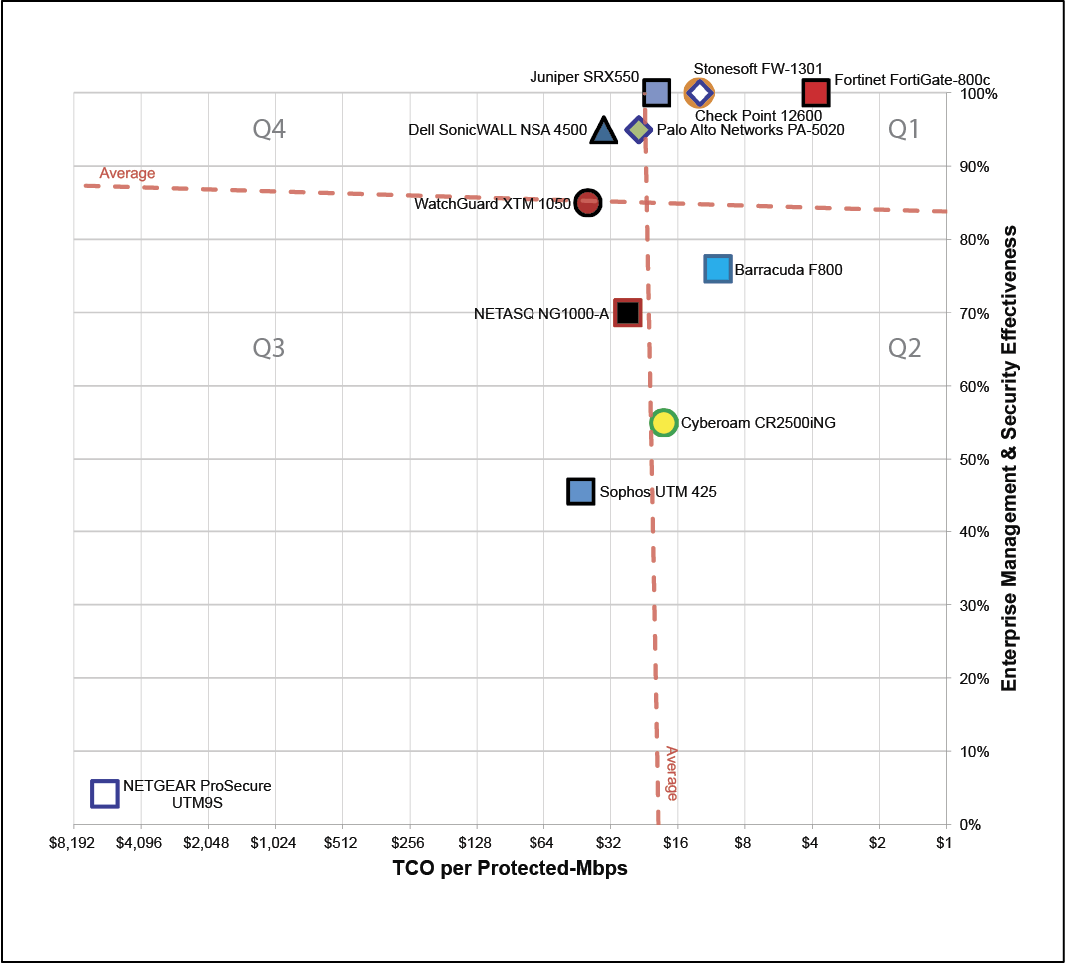
NSS Security Value Map for Firewall

Slide 7
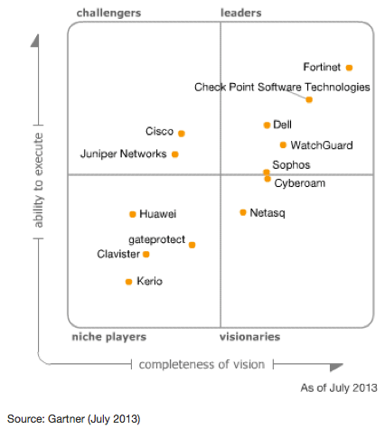
Gartner Magic Quadrant Unified Threat Management
Position Magic Quadrant
Enterprise Firewall
Position Magic Quadrant
Wired & Wireless Infrastructure
2006–2013
2012–2013
Position Magic Quadrant
Security E-Mail Gateway
Position Magic Quadrant
Application Deliver Controller
2010–2013
2005–2013

Slide 8
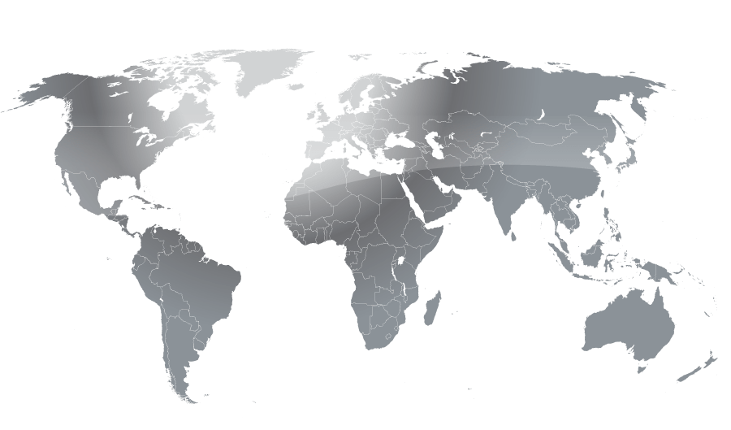
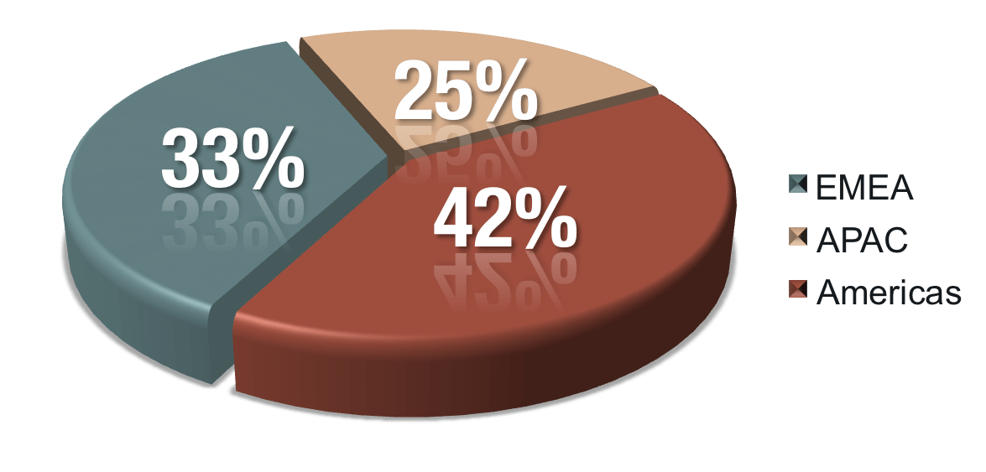
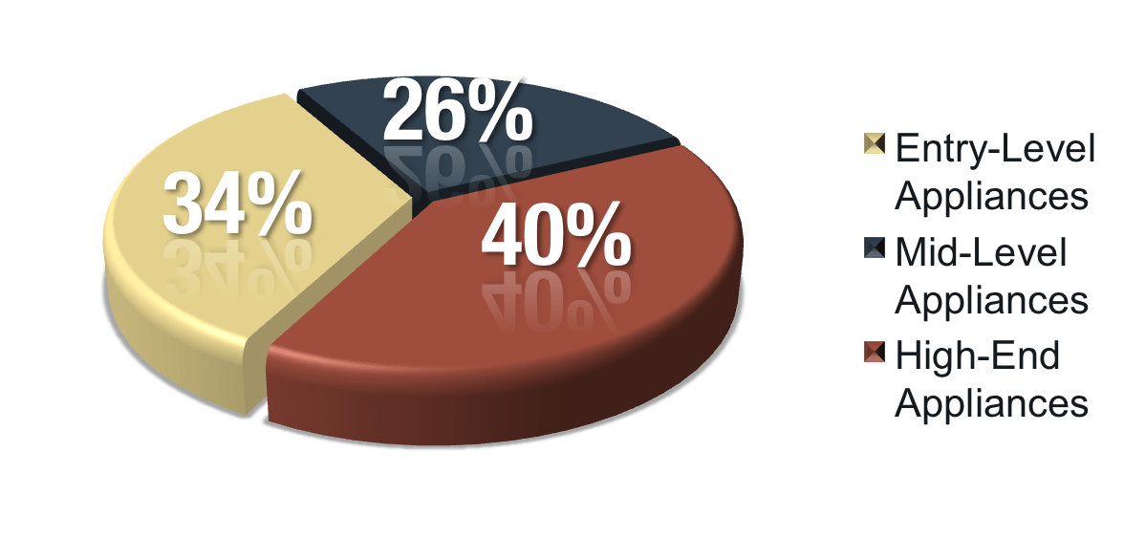
Fortinet Security = Global Success
Billings by Region
Revenue by Segment

Slide 9
Global Customers
Top 5 Global Carriers
Top 10 Fortune 500
Top 10 Global 500 Banks

Slide 10
Fortinet 3rd Largest Network Security Vendor
Worldwide Security Appliance
Market Share Q2 2013 ⁽¹⁾
Rank | Company | Market Share (%) | Growth Y/Y
1 | Cisco | 16.2 | 0%
2 | Check Point | 12.5 | 4%
3 |  | 6.2 | 13%
4 | Juniper | 5.5 | (19%)
5 | Blue Coat | 5.1 | 61%
6 | McAfee | 5.0 | 10%
 | Market Size | $8.5 Bil.
Notes
(1) IDC Worldwide Security Appliances Tracker, September 2013 (market share based on factory revenue)

Slide 11
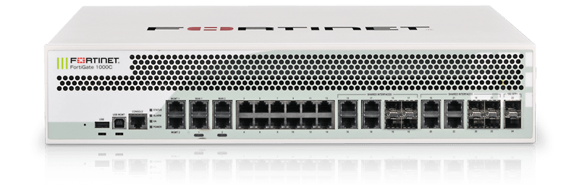
Solution Description Next Generation/Edge Firewall For the Enterprise
Today‘s Requirements
NGFW
FW/VPN
IPS/App Control
Web Filtering/Botnet Intelligence
Advanced Threat Protection
Security Updates
High Capacity/Speed
1 to 10G NGFW Throughput
IPS
AV
SSL
1G/10G Ports
Hardware
Performance
Cloud Ready
Directory Integration
Actionable Reporting
3rd Party Eco System
Compact Appliance
Power Efficient
Space Saving
Flexible HA options
ATP
Management
Operations
Security
Notes:
In addition to the a stack of traditional and advanced security capabilities, management and performance capabilities play an important role

Slide 12
Fortinet Advantage: Performance
Firewall
VPN
NGFW
UTM
Mbps
Gbps
Network Processor
Content Processor
MultiCore CPU
MultiCore CPU
Policy
Security

Slide 13
Fortinet Advantage: Security
ADVANCED
TARGETED ATTACKS
ADVANCED THREAT PROTECTION
MALICIOUS APPS
APPLICATION CONTROL
MALICIOUS SITES
WEB FILTER
SPAM BOTNETS
BANNED CONTENT
ANTI-SPAM
Performance / Damage
TROJANS
ANTIVIRUS
VIRUSES & SPYWARE
INTRUSIONS & WORMS
IPS
Layer 5-7: CONTENT & APPLICATION
VPN
Layer 3-4: CONNECTION
FIREWALL
HARDWARE THEFT
Layer 1-2: PHYSICAL
LOCK & KEY
1980s
1990s
2000s
2010s
Today
Method
Notes:
Fortinet’s approach was to create Unified Threat Management. The UTM solution, which tightly integrate many functions and point products together into a single platform.
UTM is defined as a device that “Unifies” multiple security features, including firewall/VPN, Intrusion Detection/Prevention and gateway antivirus, at a minimum, Fortinet offer s all these plus much more features.
We also leverage our FortiASIC to accelerate performance, and utilize our FortiGuard Labs for real-time global update service, this solution effectively protects our customers in today’s challenging network environment

Slide 14
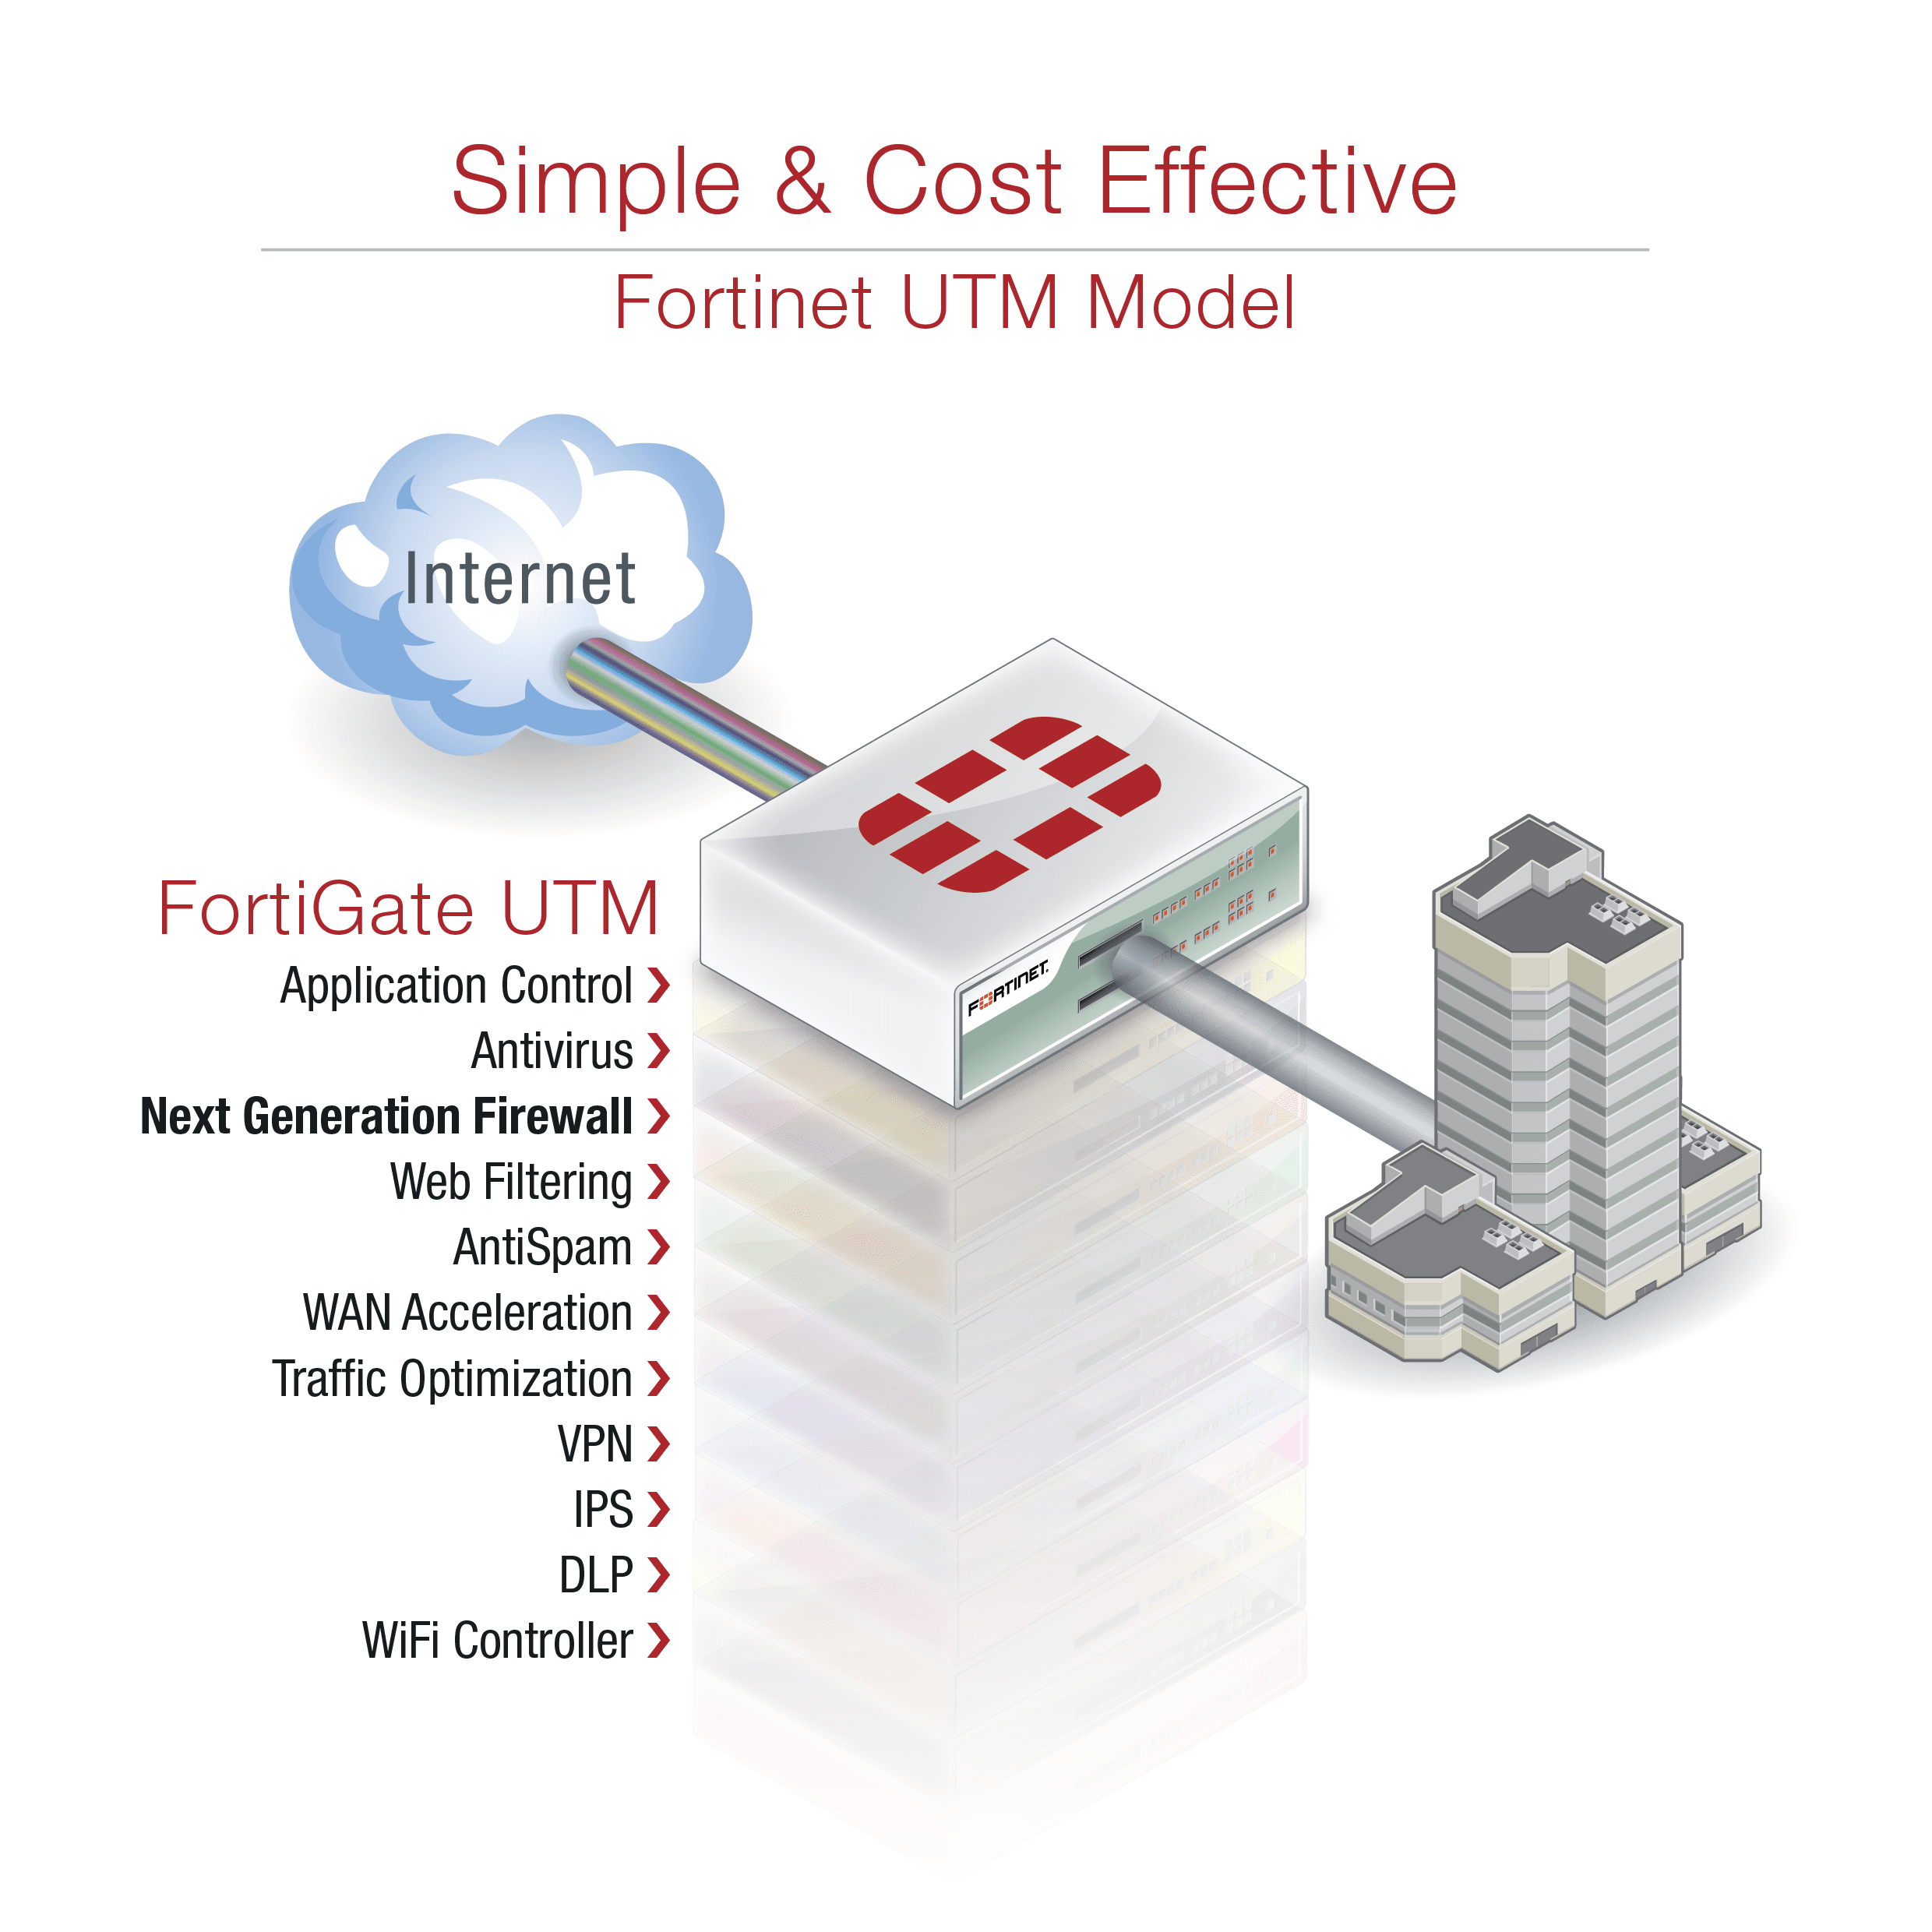
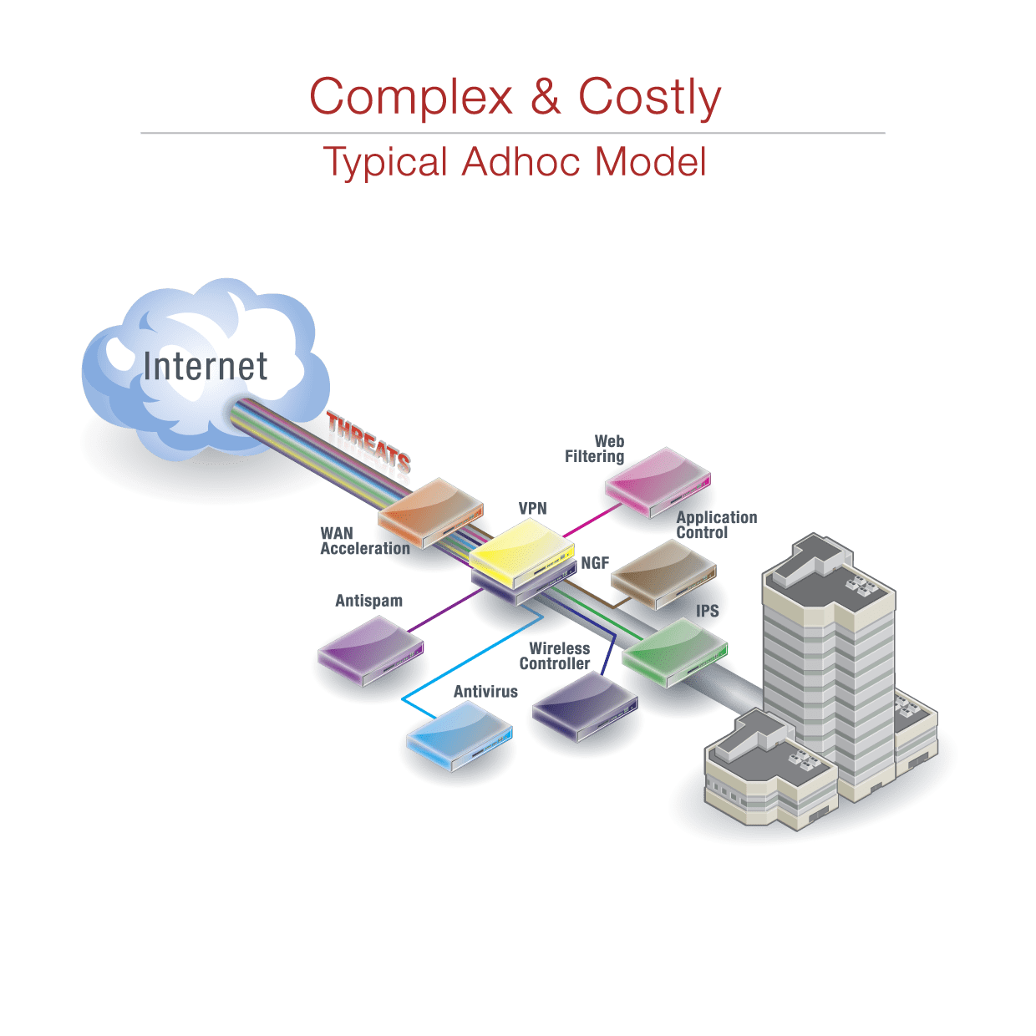
Fortinet Advantage: Consolidation

Slide 15
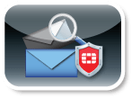
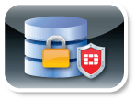
What is FortiGuard?
FORTIGUARD ANTIVIRUS SERVICE
FORTIGUARD APPLICATION
CONTROL SERVICE
FORTIGUARD ANTISPAM
SECURITY SERVICE
FORTIGUARD INTRUSION
PREVENTION SERVICE
FORTIGUARD WEB
SECURITY SERVICE
FORTIGUARD WEB
FILTERING SERVICE
FORTIGUARD DATABASE
SECURITY SERVICE
FORTIGUARD VULNERABILITY
MANAGEMENT SERVICE
FORTIGUARD IP REPUTATION
SERVICE
FortiGuard Services

Slide 16
Threat Intelligence & Response
400+ Researchers
Millions of sensors
Collaboration
Threat Monitoring
Fortinet’s Own
Notes:
The Microsoft Active Protections Program (MAPP) is a program for security software providers. Members of MAPP receive security vulnerability information from the Microsoft Security Response Center (MSRC) in advance of Microsoft's monthly security updates.

Slide 17
Threat Intelligence and Response
50,000
41,000
10,000
Spam e-mails
intercepted
Network intrusion attempts resisted
Malware programs
neutralized
2,500
70
Application
control signatures
47,000
20,000
Intrusion prevention signatures
70 Terabytes
8,000
Of Threat Samples
Attempts to access malicious websites blocked
Botnet command and control attempts thwarted
Hours of research in labs around the globe
12,000
10 Million
190,000
Vulnerability management signatures
New and updated antivirus definitions
250 Million
Website categorization requests
66 Million
Rated websites in 78 categories
New and updated antispam signatures
900
600,000
Web application firewall attack signatures
URL ratings for web filtering

Slide 18
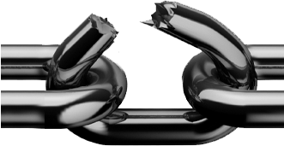
The Threat Landscape - 2014
What are APTs? Defining Advanced Persistent Threats – D.S.I.
DISGUISE
Advanced threats focus on disguise to slip past security detection
SURVIVABILITY
Persistent threats aim to survive on systems as long as possible
IMPACT
Hard drive killers
Stolen IP, customer data
Blackmail & Ransom
Critical infrastructure
Detect Disguise,
Kill the Chain
Reduce Survivability,
Break Impact
Notes:
18
TODO:
Add animation of breaking and Impact going away.
Kill Chain Model: Attempt to break the chain early, to avoid the snowball effect
Break at Disguise: Uncover the threat and mitigate early, and there is no Survivability or Impact
Break at Survivability (some point): The impact is much less than it could have been if it survived

Slide 19
FortiGuard: Continuous Protection
KNOW
Defend Against
Malware Families
SHARE
SUSPECT
Update Devices
Industry Conferences
Raise awareness
Real Time Sandbox Research Intelligence Identify New Malware
LEARN
Research Team Analysis
Cloud Based Sandbox
Industry Partnerships
Notes:
Know – This is the FortiGate (or other appliance, FML, FWB, FCH…), actively blocking using the Fortinet compact pattern recognition language to describe malware (or we could reference web content filtering)
Suspect – This would be suspicious content as detected by the AV Engine
Learn – This is the research team, and tools learning about new malware / threats- industry partnerships, CERT, Microsoft and other agencies to exchange information
Share– Two parts to this,
pushing updates to the FGT to ensure the latest set of CPRL signatures is Known
Educating peers via industry conferences, and general awareness raising via established press, sales and marketing channels.

Slide 20
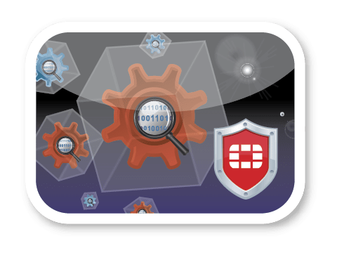
FortiSandbox
Solving the Sandbox Problem Look first for what we know, then inspect suspicious
Deep AV Scan & RTS
96% RAP before Sandbox
No need toSandbox if caught
Cloud Check
Real time check on latest malware rating
Full Sandbox
Catch anything not caught by signature detection
Downloaded & Dropped Files
Recursively Scanned
Forensics
Behavior Report
Notes:
20
Scan with CPRL /RTS first
Cloud check on no detection
If still no detection, run through full sandbox
Output is forensic analysis
Send further files that were dropped onto the system to step #1 for recursive scan
Collect all data, including files, and upload (if configured) to FortiGuard / FortiCloud.
All files should get signatures and WCF ratings for malicious domains the malware contacted

Slide 21
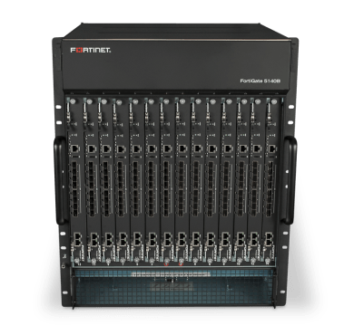
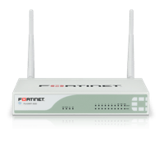
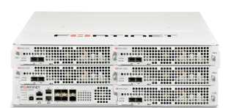
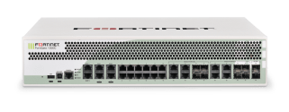
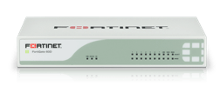
Recommended Product- FortiGate Series Next Generation/Edge Firewall For the Enterprise
MSSP
Carrier
Data Center
Core Enterprise
Distributed Enterprise
SMB
 | 20-90 Series | 100-800 Series | 1000 Series | 3000 Series | 5000 Series
Hardware | Desktop | Mid Range |  | High End
Security Applications | UTM | Firewall, IPS, NGFW, UTM

Slide 22
Thank You

